Slide 1

Topic
Data for a Green Future: Prioritizing Environmental and Climate Change Statistics in National Strategic Frameworks
Team: USABYIMANA Monique
NKUNDIMANA Donath
HANYURINEZA Emmanuel
INGABIRE Annonciata

Slide 2

Project overview and rationale
1.Objectives
project proposes the development of an integrated climate and environmental data platform. The system will improve data collection, management, visualization, and use aligned with NST2 and NSDS 4 priorities.
Project Objectives:
Strengthening the production, quality, and accessibility of environmental and climate statistics.
Integrate statistical indicators into national development frameworks and reporting cycles
Build national capacity in data science, visualization, and environmental modeling.

Slide 3
Project overview and rationale
Problem statement
Environmental and climate change statistics are often fragmented, outdated, or inconsistent across agencies. This limits their real-time utility in policy design, monitoring, and alignment with national strategies like NST2 and NSDS 4. The current statistical systems may lack integration, interoperability, or the capacity to support climate-smart decision-making.

Slide 4
Project overview and rationale
Relevance
The important of this Data Use Case for our institution
NST2 (National Strategy for Transformation) aims to ensure inclusive economic growth while safeguarding ecosystems.
NSDS 4 emphasizes the modernization of statistical systems, with environmental data as a core focus up to 2029 to come up with compilation of green GDP

Slide 5
Methodology and visualisation
Time Series Analysis: to monitor trends in ecosystems.
Geospatial Analysis: for mapping environmental statistics.
Machine Learning: to forecast future climate scenarios.
Data Integration: linking environmental indicators with SDGs and NST2/NSDS4 targets
Tools and Frameworks
Data Engineering: Python,
Visualization: Streamlit, Dash, Searborn (etc)
Geospatial Tools: GGIS
Backend/API: FastAPI, PostgreSQL/PostGIS
Metadata

Slide 6
Team Roles & Responsibilities
Role | Core Responsibility
Data Management with Cleaning and Statistical Modelling | USABYIMANA Monique
Data Engineering, Statistical Modelling, Machine Leaning and data visualization Team Lead | NKUNDIMANA Donath
Project Systems Engineer and Core Backend Developer | HANYURINEZA Emmanuel
AI Senior Developer and Full System Automation With quality Assurance | INGABIRE Annonciata

Slide 7
Team Responsibilities
Key Activities
Oversees project alignment with NST2 and NSDS 4 priorities.
Builds and maintains the interactive data platform/dashboard. Ensures the user interface is intuitive, accessible, and accurately displays all statistical indicators.
Builds and maintains the interactive data platform/dashboard. Ensures the user interface is intuitive, accessible, and accurately displays all statistical indicators.

Slide 8
Progress and achievements
Key achievements
Actual product: Demo screenshots
Current status: the present stage of our project (data collection, analysis, model development, visualization)

Slide 9
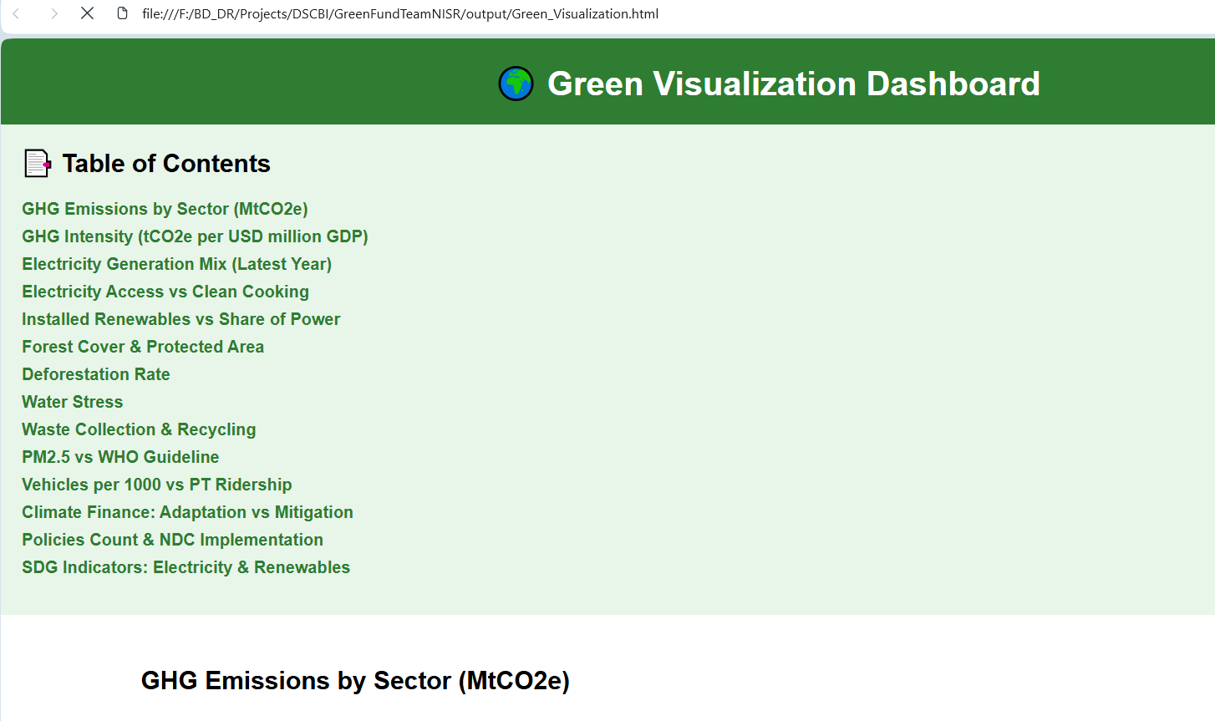
Brief visualisation on the project samples Interactive dashboard
file:///F:/BD_DR/Projects/DSCBI/GreenFundTeamNISR/output/Green_Visualization.html

Slide 10
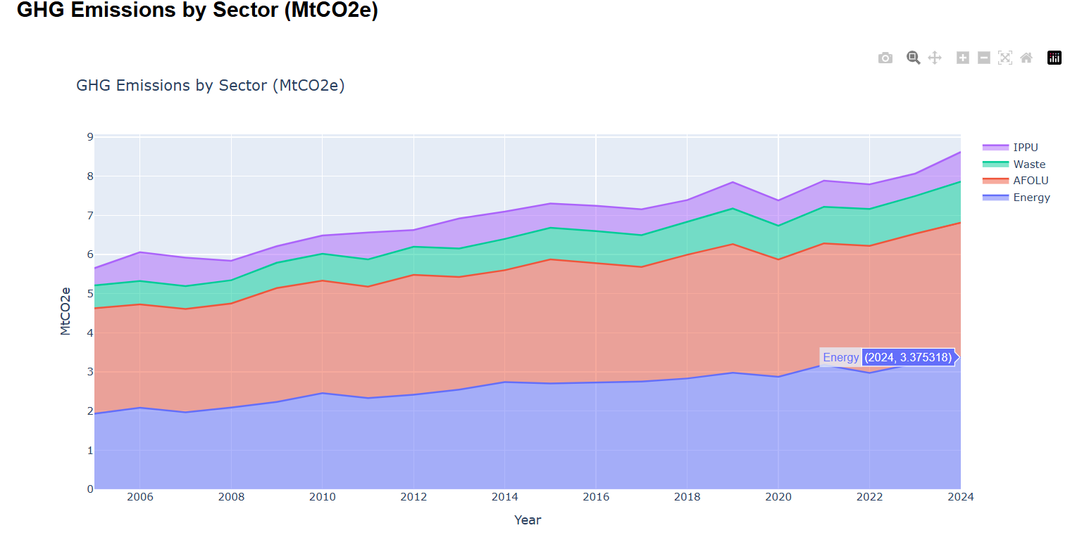
Brief visualization on the project samples
file:///F:/BD_DR/Projects/DSCBI/GreenFundTeamNISR/output/Green_Visualization.html

Slide 11
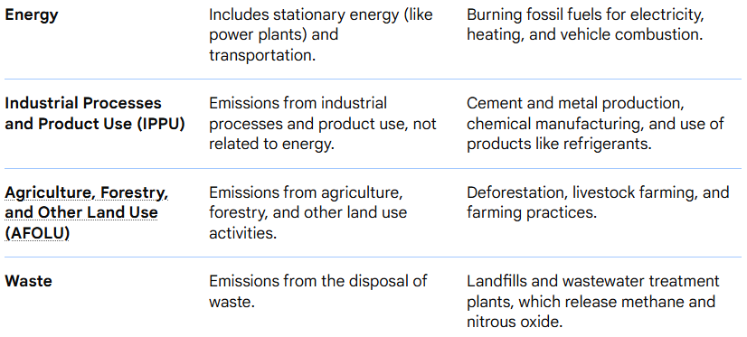

Slide 12
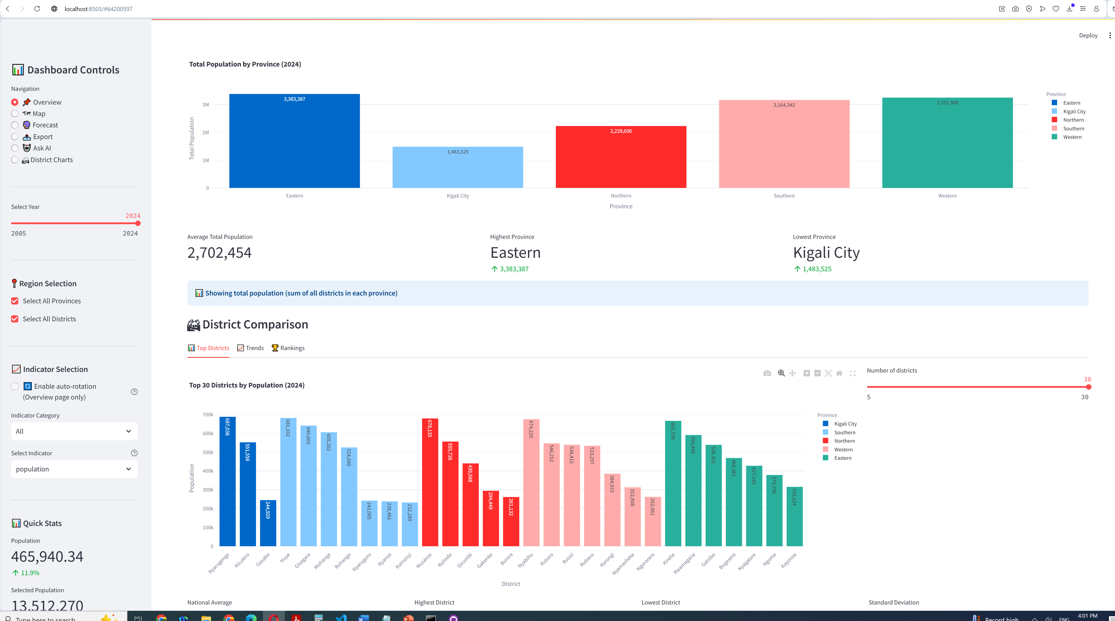

Slide 13
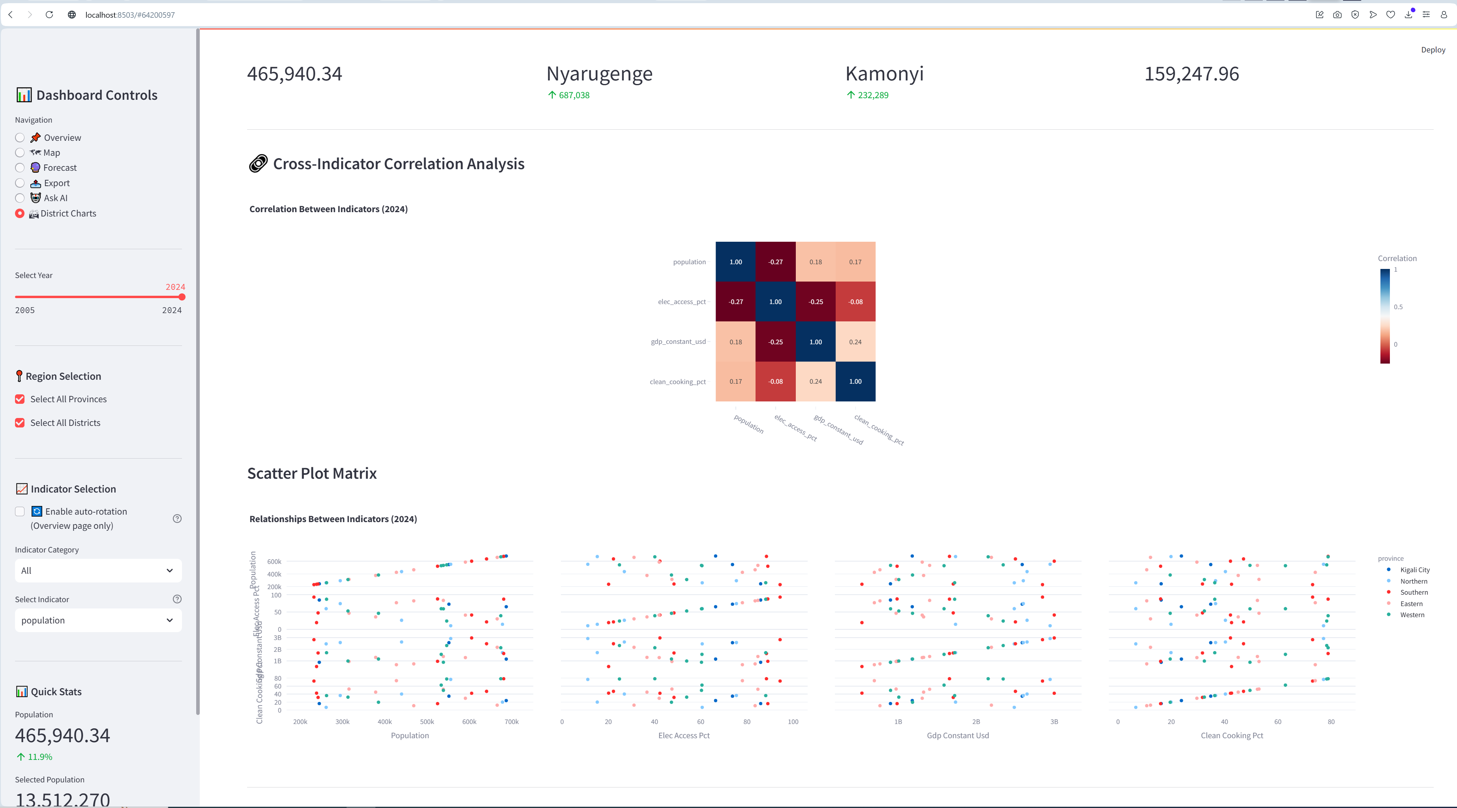

Slide 14
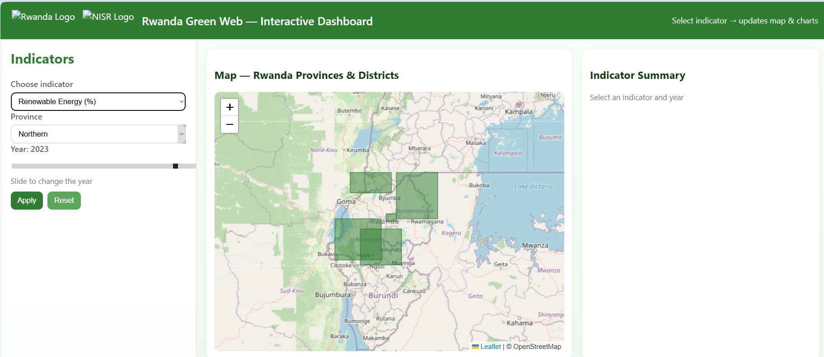
Brief visualisation on the project samples Interactive dashboard

Slide 15
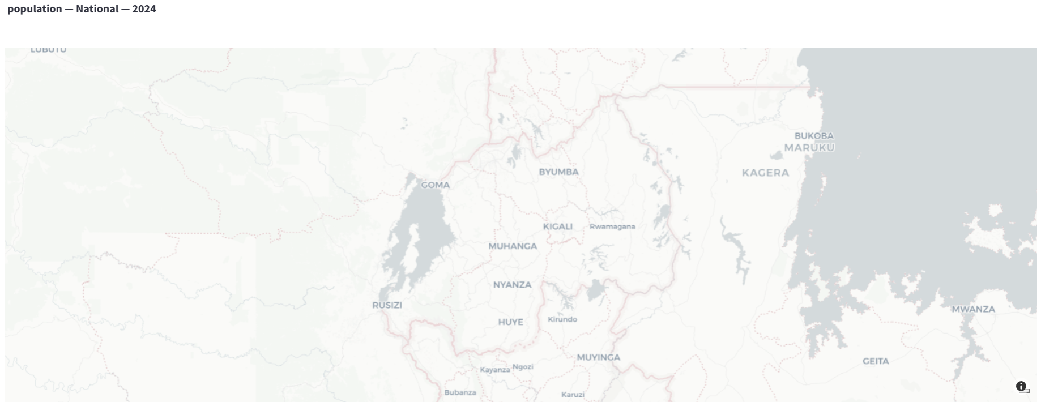
Brief visualization on the project samples Interactive dashboard

Slide 16
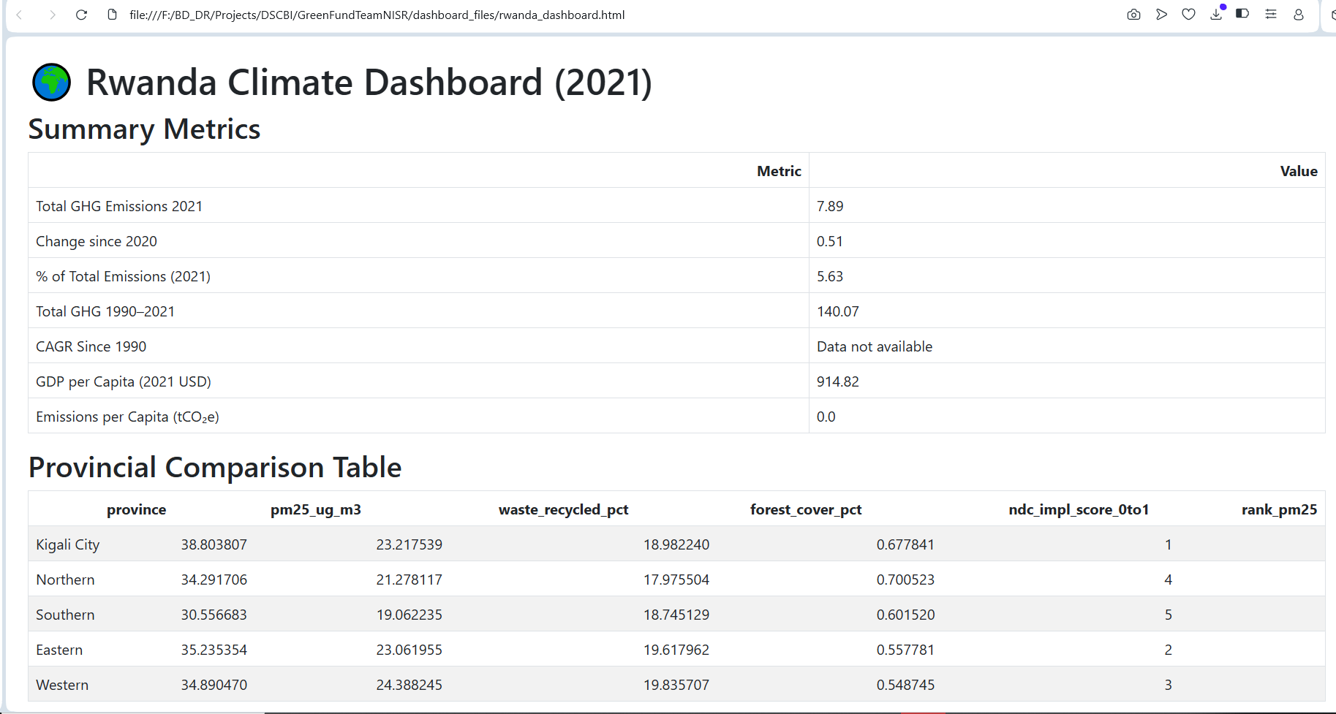
Brief visualisation on the project samples Interactive dashboard
GHG: GreenHouse Gaz
file:///F:/BD_DR/Projects/DSCBI/GreenFundTeamNISR/dashboard_files/rwanda_dashboard.html

Slide 17
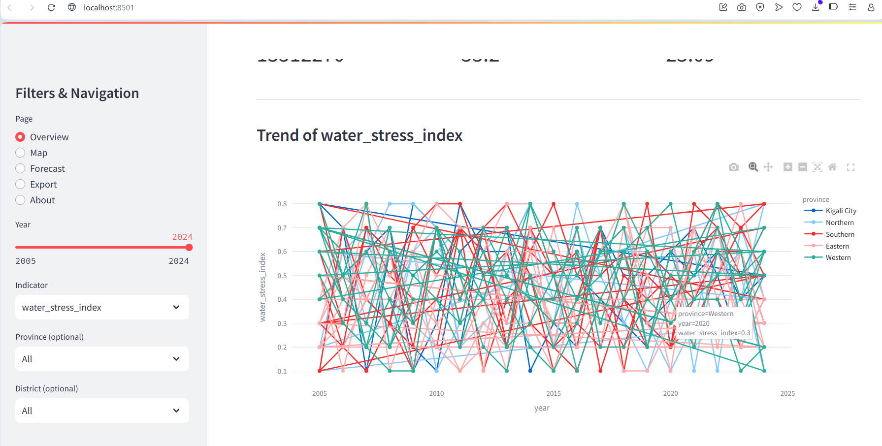
Brief visualisation on the project samples Interactive dashboard
http://localhost:8501

Slide 18
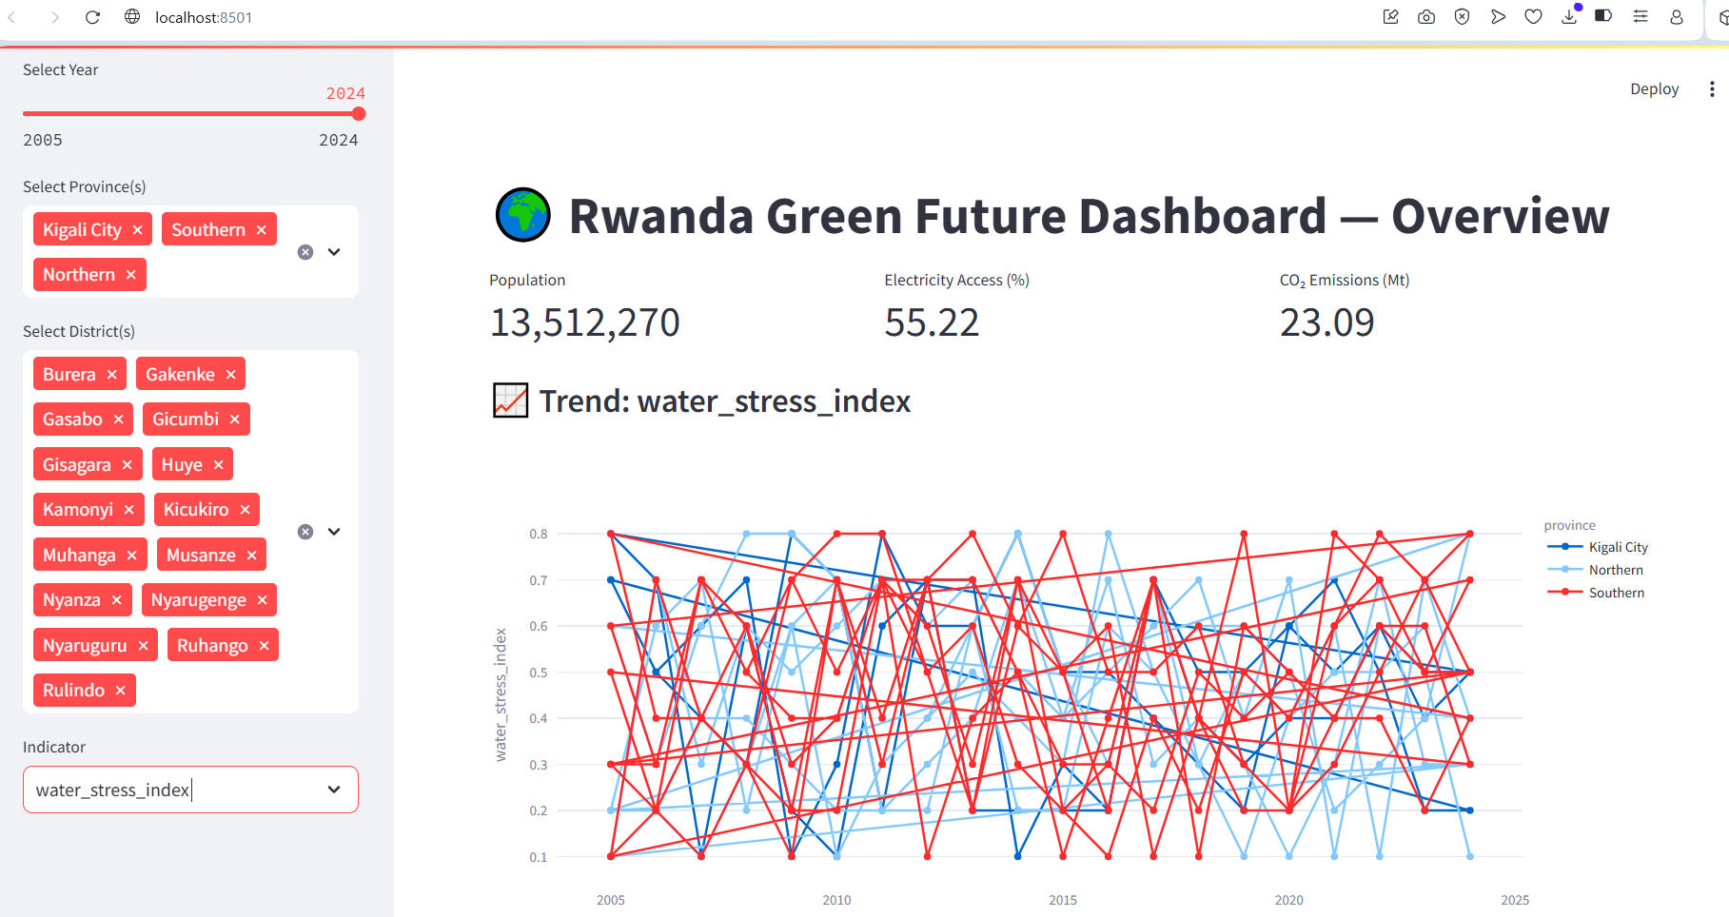
Brief visualisation on the project samples Interactive dashboard

Slide 19
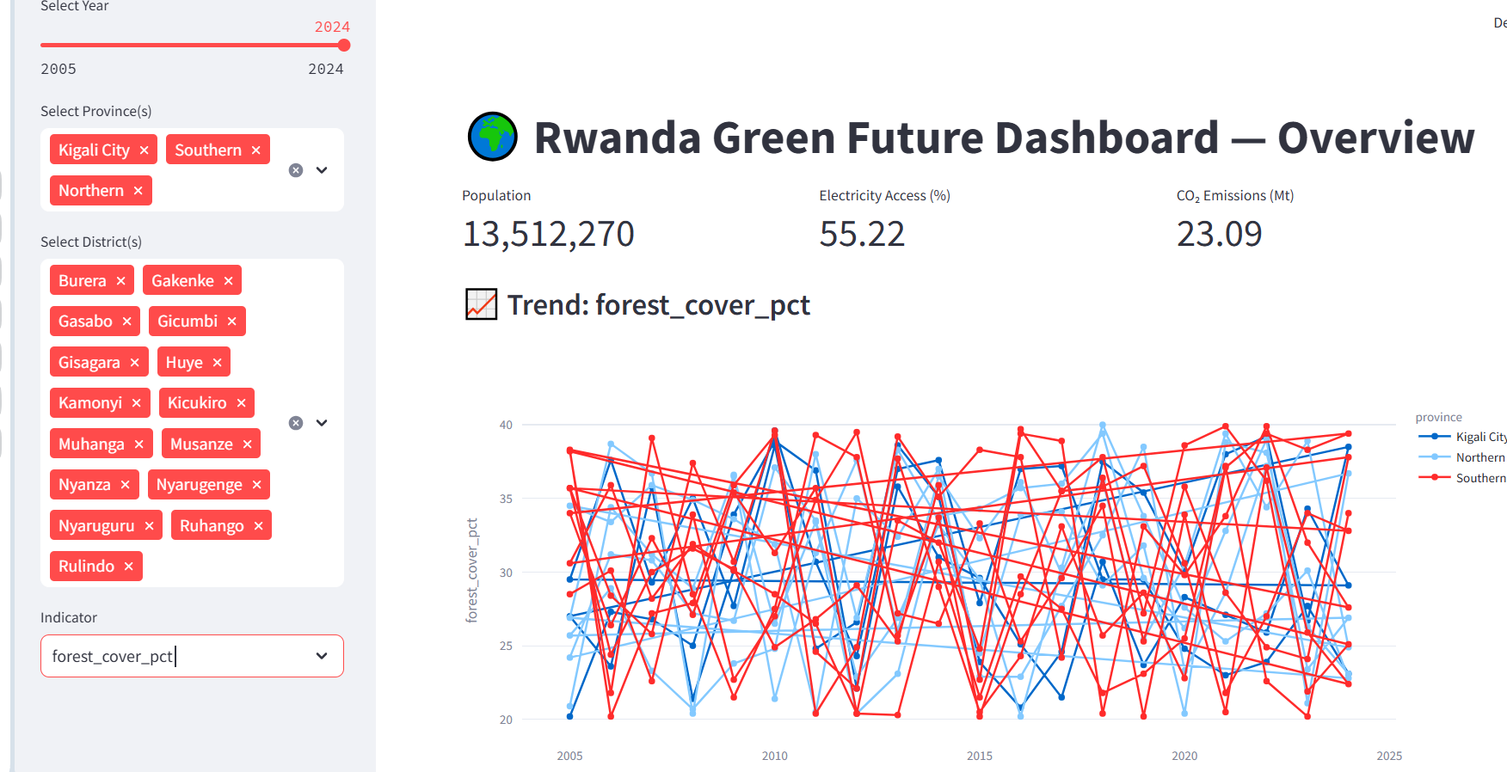
Brief visualisation on the project samples Interactive dashboard

Slide 20
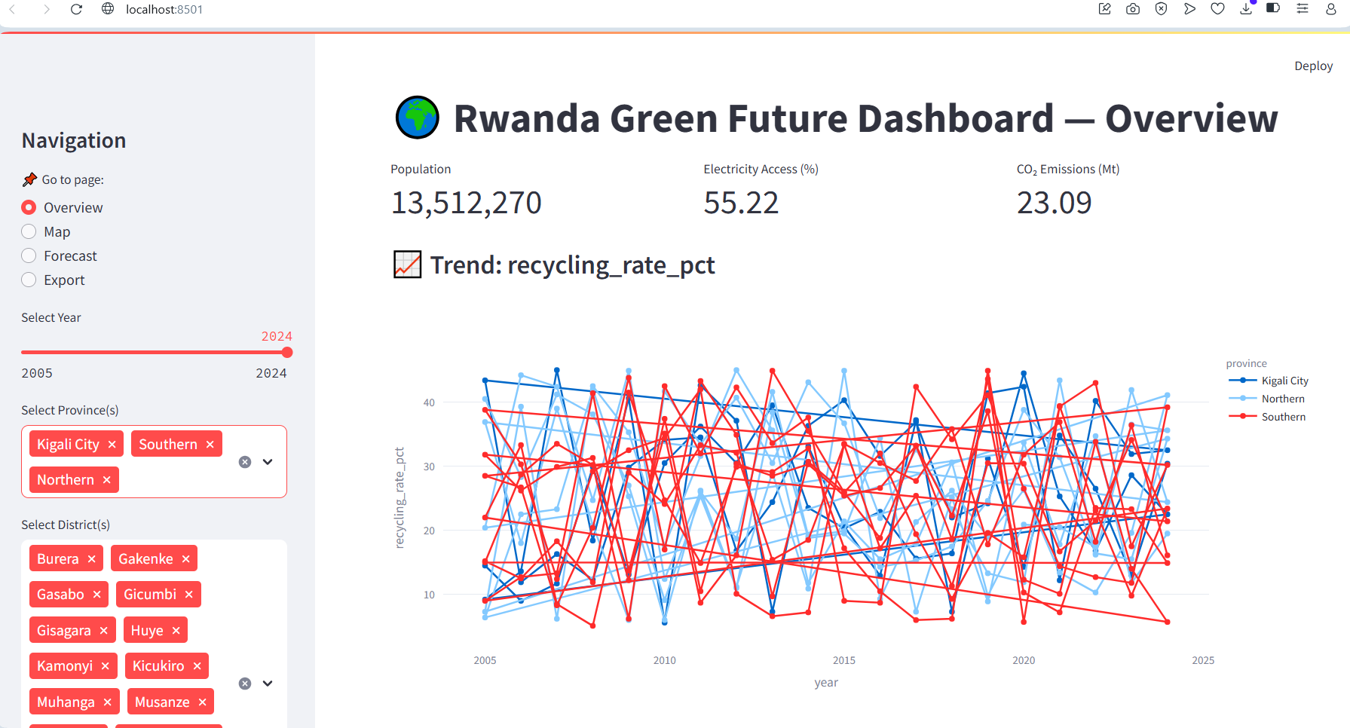
Brief visualisation on the project samples Interactive dashboard

Slide 21
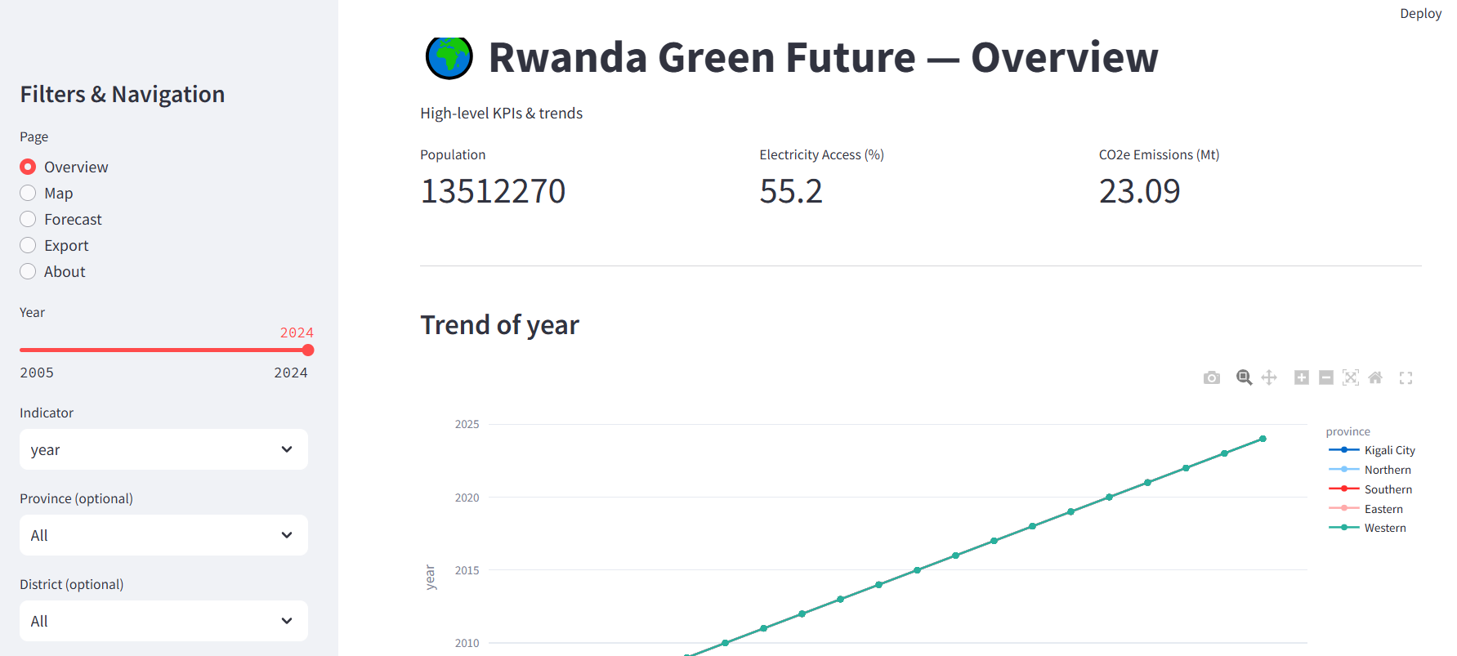
Brief visualisation on the project samples Interactive dashboard

Slide 22
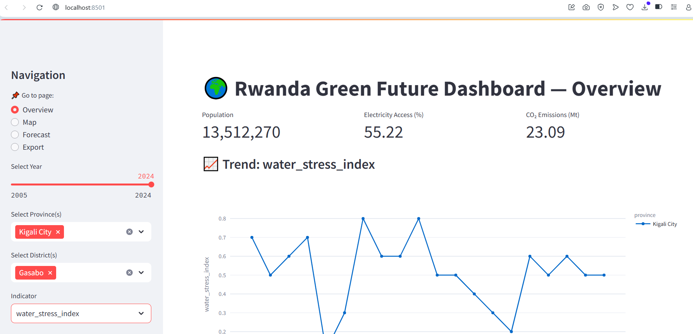
Brief visualisation on the project samples Interactive dashboard

Slide 23
Brief visualisation on the project samples Interactive dashboard

Slide 24
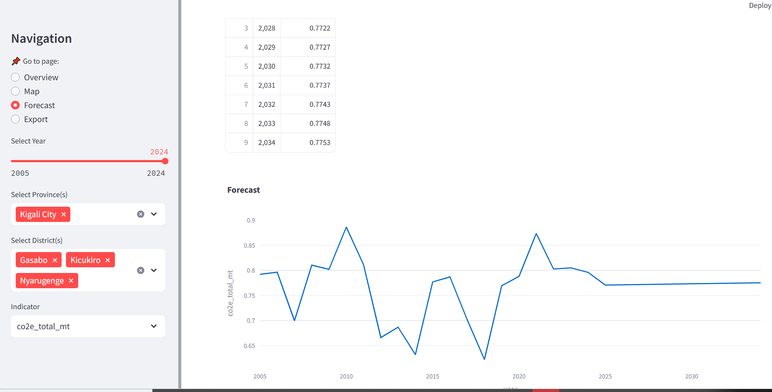
Brief visualisation on the project samples Forcast

Slide 25
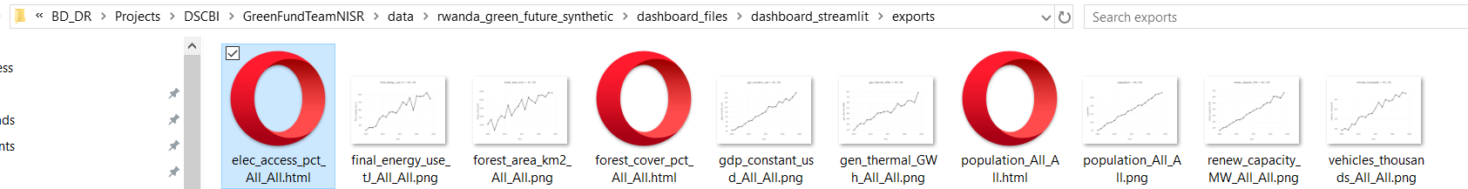
Brief visualisation on the project samples Data exported

Slide 26
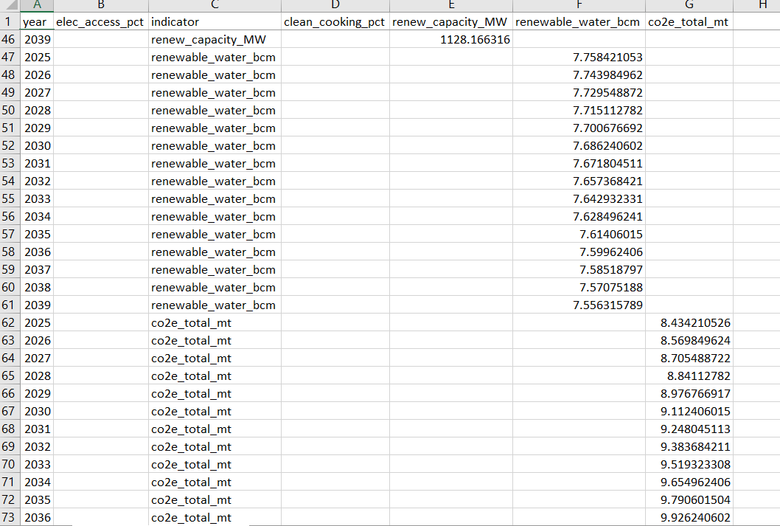
Brief visualisation on the project samples Forcast

Slide 27
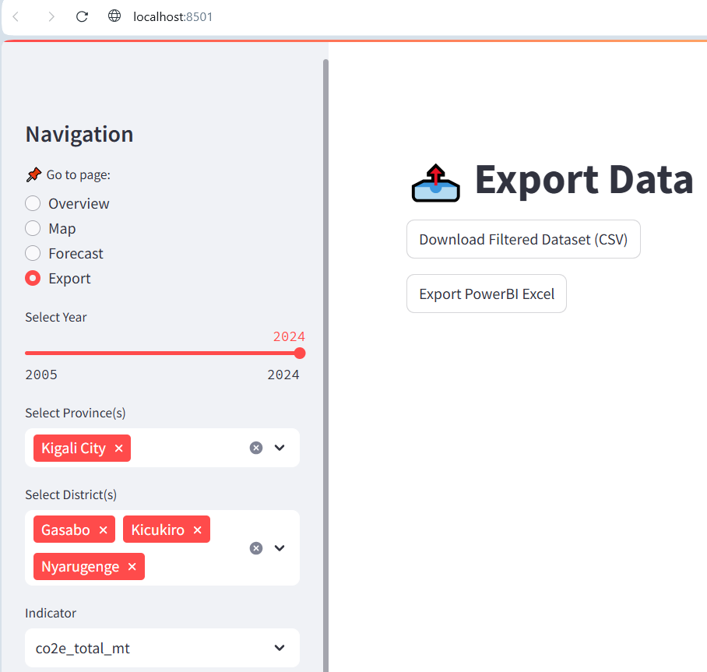
Brief visualisation on the project samples How to export csv dataset and powerBI Excel

Slide 28
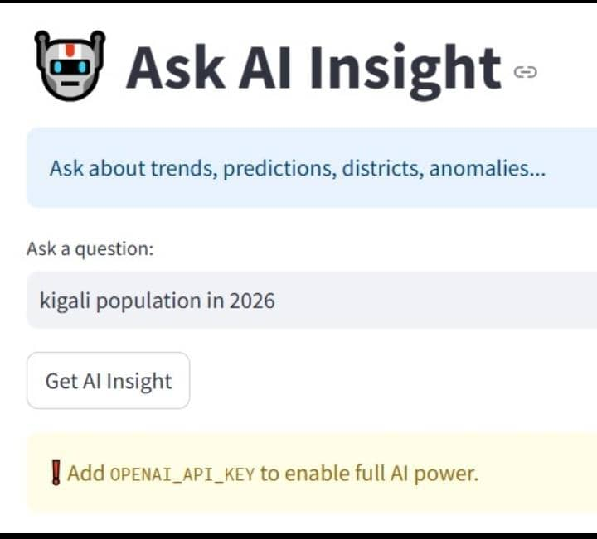
Rwanda Green AI Use Integration

Slide 29
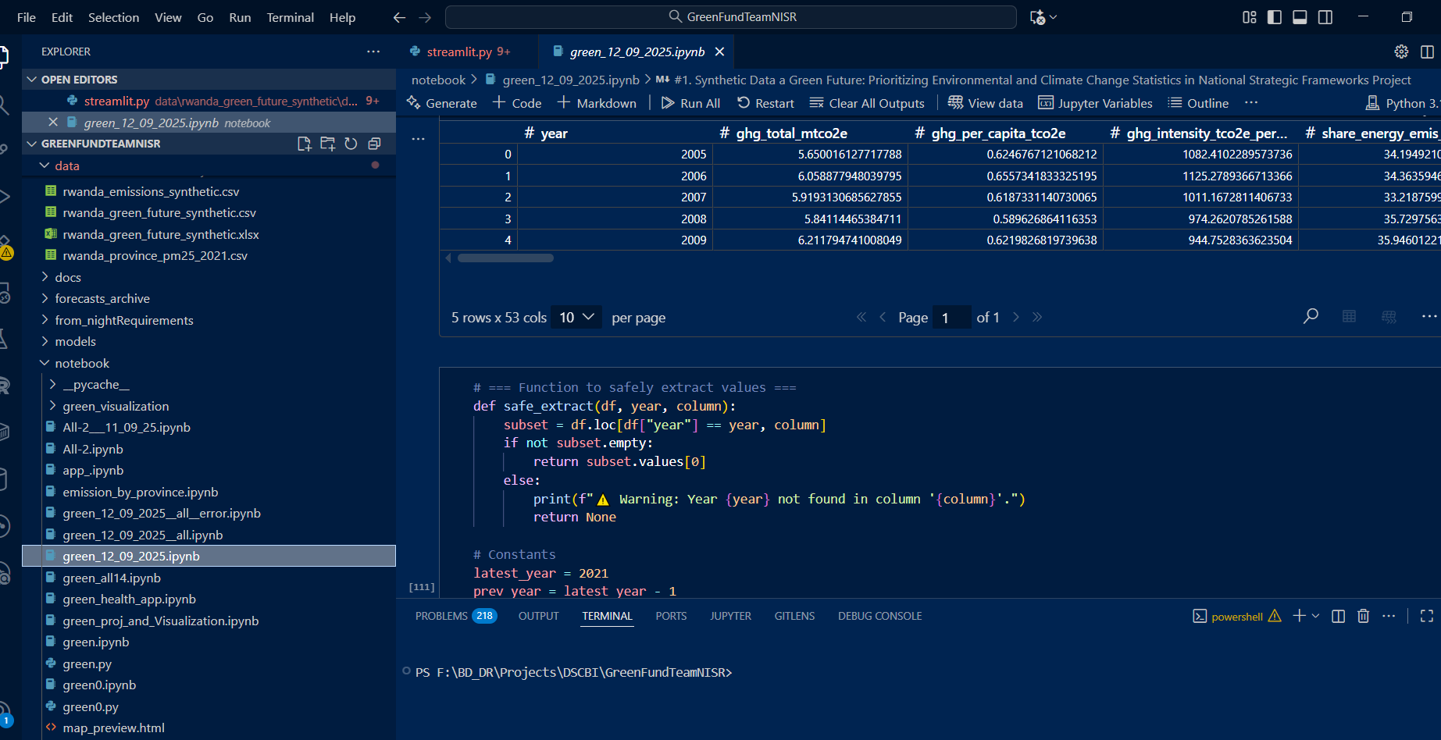
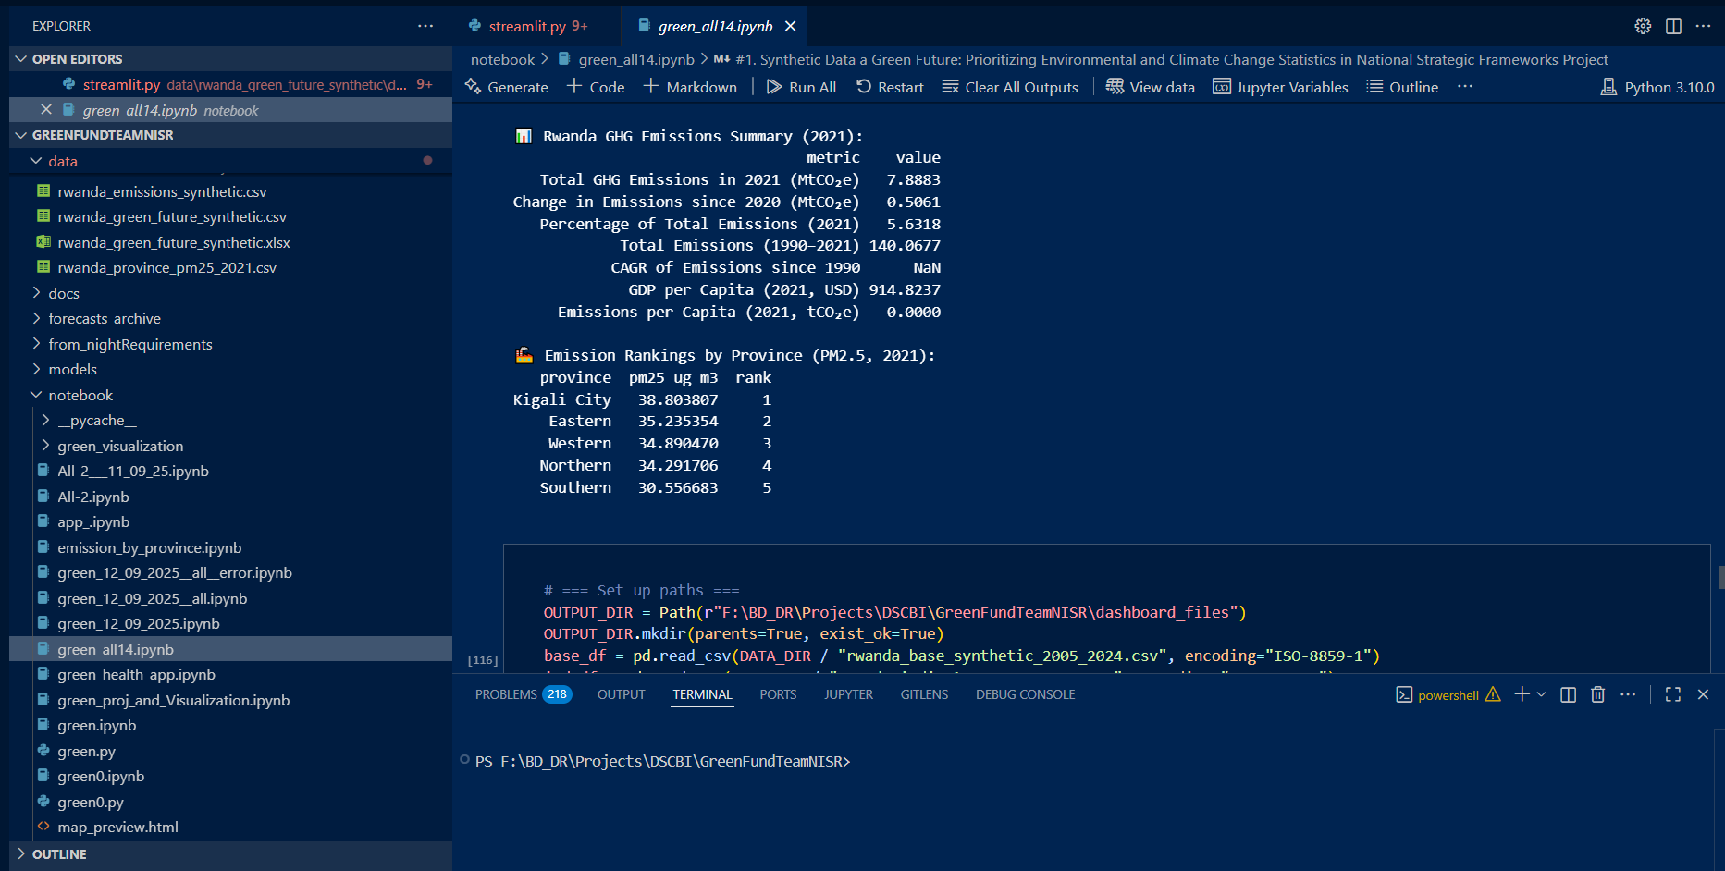
Brief visualisation on the project samples Example of runed commandes
OUR CODES

